Slide 1
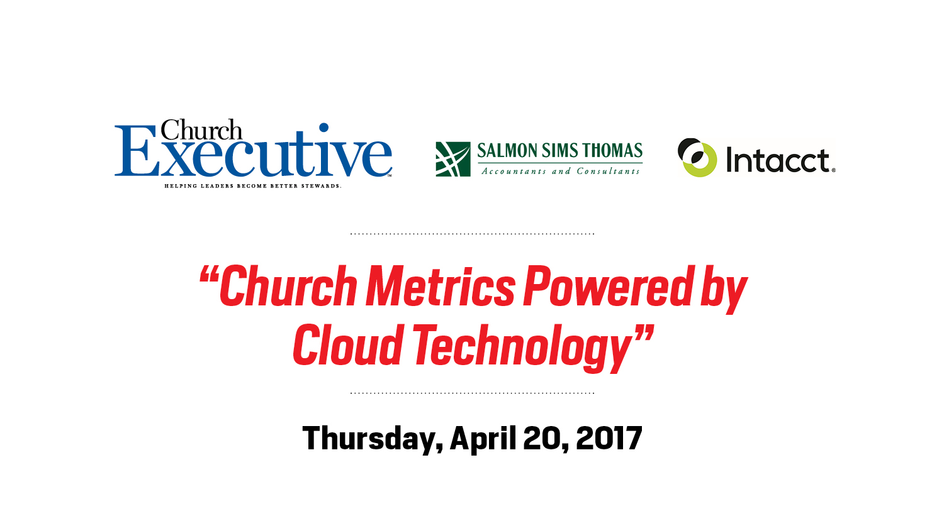

Slide 2
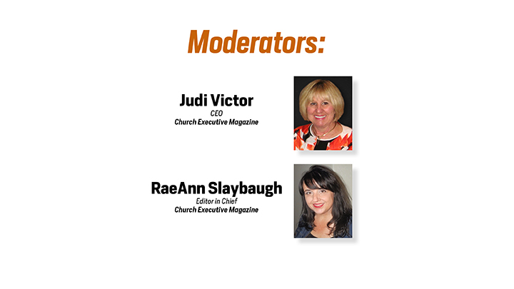

Slide 3
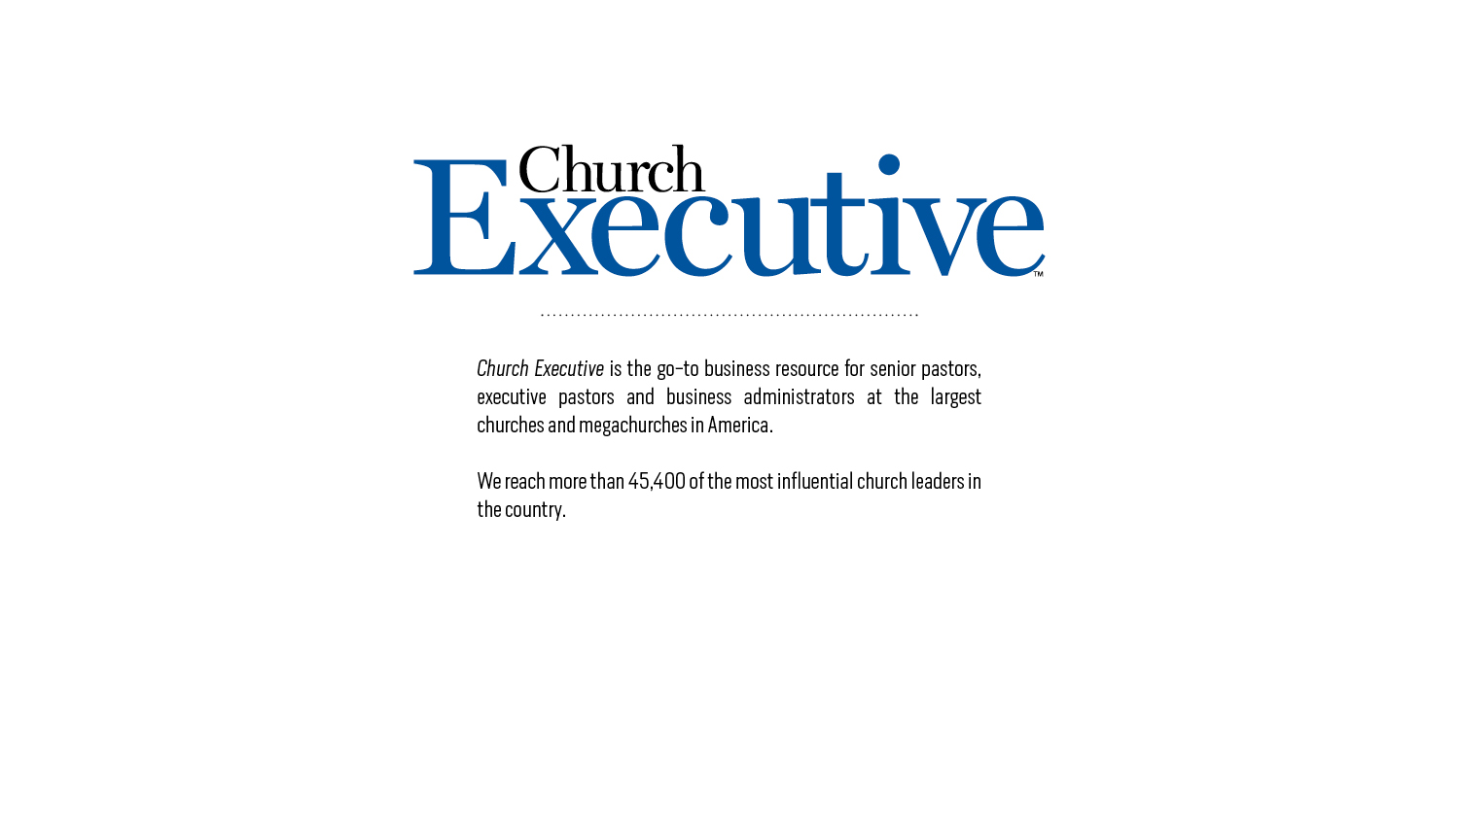

Slide 4


Slide 5


Intacct in not just an accounting software.
Intacct helps finance teams increase efficiency, and drive growth and stewardship for churches and ministries. The difference between Intacct and the other accounting solutions is how it makes your organization different from your non-profit peers.
It allows:
Process automation allowing day-to-day business processes run better (accurate and effective)
Users to have greater insight and flexibility to make confident long-term decisions and execute changes.
Notes:
Intacct supports all types of nonprofit organizations including the following:
Faith-based Organizations
Philanthropic Organizations
Health & Human Services Organizations
Membership Organizations
Educational Nonprofit Organizations
International Nonprofits and NGOs
Intacct is acknowledged as the preferred provider of financial applications by the American Institute of Certified Public Accountants and
Salmon Sims Thomas is a value added reseller for Intacct.

Slide 6
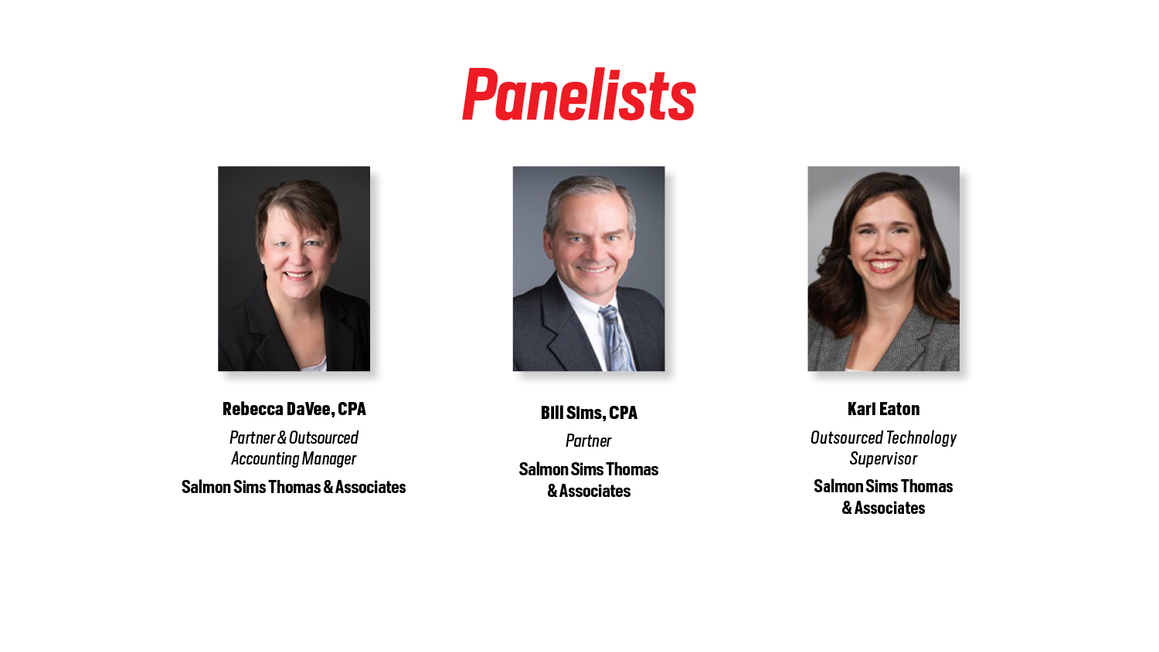

Slide 7

Learning Objectives
Understand a metric and how to effectively interpret and relate to ministry and governance
Top 10 sustaining metrics defined for churches
Explain the benefits of cloud-computing
Relate metrics to customized cloud-integrated dashboards using Intacct
Notes:
Becky - Before we dive into our metrics – let’s briefly go over what we would like to accomplish this morning….
Click after “Let’s Get Started”

Slide 8

If a picture is worth a thousand words……
Notes:
Becky - Most adults understand that this picture is an excerpt from a very famous painting by Michelangelo. How many people know the title of the artwork. I didn’t until I looked it up in Wikipedia.
I know what this drawing says to me. This drawing speaks of God reaching down to man. The name of the painting is “The Creation of Adam” and the artwork has become iconic of humanity. This picture speaks volumes and causes an emotional response from every observer.
So if a picture is worth a thousand words… (Next slide)

Slide 9

Then a thousand pictures is worth what?
Notes:
Becky - Then this picture tells your what? Wow – does this art speak to you? It has color, images, and splash. I think it looks like splash.
’m not sure what the artist intended to say or make you feel – but you feel “something” when you look at this picture.
This “something” will be different for most people because of our diverse personal l backgrounds, beliefs and experiences. Pictures often tell a story.
As a ministry volunteer and CPA, I like stories however I love numbers. I like sequential data so that I can understand (Kari advance slide) ministry activities and translate ministry opportunities to church leaders.

Slide 10

Numbers ALWAYS tell a Story.
Notes:
Becky: Here’s a true or false question…. Numbers ALWAYS tell a Story….. True or False
Bill – what do you think?
I believe the answer is true….. HOWEVER the user of the information must understand the context for the numbers. Numbers represent data or digits. But what is connected to the numbers give you the basis to draw a conclusion about the data. (Kari advance slide)
For example…

Slide 11

Business transaction…
Notes:
Bill- by looking at this picture - you can easily see a business transaction. This picture gives you an inside view of a common neighborhood activity or sale. Operations that hopefully generated a profit. A picture that translates relevance.
Becky – Metrics also paint a picture. A picture that defines (Kari advance the slide) efficiency or effectiveness.

Slide 12

Definition of Metrics
A “standards of measurement” by
which efficiency, performance,
progress, or quality of a plan,
process, or product can be
assessed.
Notes:
Becky: Look at this metrics definition.

Slide 13
Definition of Sustainability
1. Numbers divided by numbers = A Ratio
(e.g. numerator/denominator)
2. Ratio = Performance Metric
3. Performance Metric = Effective or Efficient Ministry Activity/Program
4. Effective/Efficient Ministry + Stakeholders = Sustainability
Notes:
Becky – read slide – slowly…
Stakeholders – who are the church stakeholders? (Significant donors, ministry volunteers, executive leadership and employees)
What do metrics (Kari advice slide) provide our stakeholders?

Slide 14

The Value of Metrics?
KPI = Key Performance Indicators
What gets measured, gets managed……
A church isn’t just about numbers – but what do numbers tell:
a. Business Administrators
b. Ministry leaders
c. Governing board
Notes:
Becky – what does your operating and financial data tell executive leadership? It’s not just numbers…. Remember there is a sequential story.
What does:
Cars in the parking lot,
Babies in the nursery
Sunday school attendance
Giving units per location or by service
On-line worshipers
Text-to-give donations
This list of data – indicates something. If you can measure it – you can define a story. It can become something that you can effectively manage. (Kari advance slide)

Slide 15
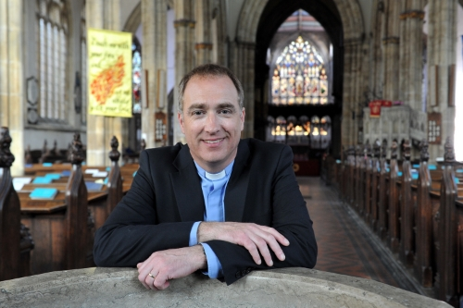
Top 10 Metrics – 3 Strategic Types
Operational Metrics – 6 metrics
Developing donors
Effective fundraising
Operating expenses
Personnel
Facility Management
S-T resources
Notes:
Becky – We have developed our top 10 metrics for churches. These metrics are divided into the following 3 groups:
Operational Metrics – 6 metrics
Managed Resources – 3 metrics
Sustaining Reserves – 1 metric
Operational metrics look at sources and uses of funds. Cash in and cash out. Churches typically have 52 operating cycles – 7 days a week/ 52 weeks a year. Financial trends and KPIs can be developed week over week, month over month, year over year.

Slide 16
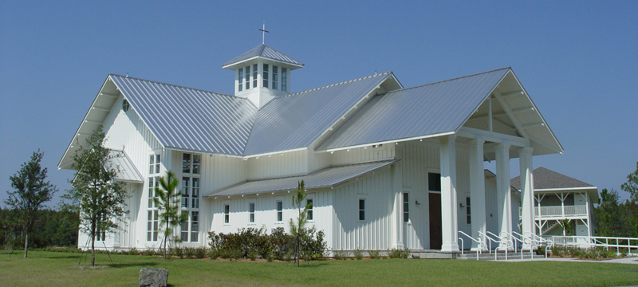
Top 10 Metrics – 3 Strategic Types (Cont’d)
Managed Resources Metrics – 3 metrics
External financing
Asset invested in operations
Income producing assets
Notes:
Bill:
As churches accumulate resources, funds are typically invested in long-term assets that are used in conducting their exempt purpose. Property and equipment are purchased and used to conduct religious activities. These assets may be debt financed or they could be assets that are used to produce income – such as marketable investments. Churches may receive endowments that are intended to be used in perpetuity and in those cases – the earnings from those investments can be used for donor directed activities.

Slide 17
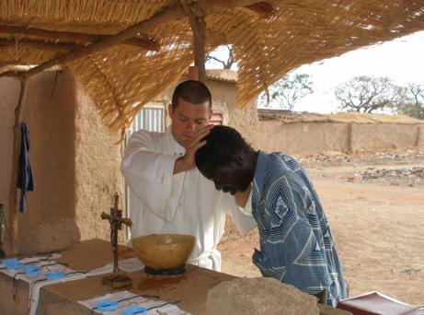
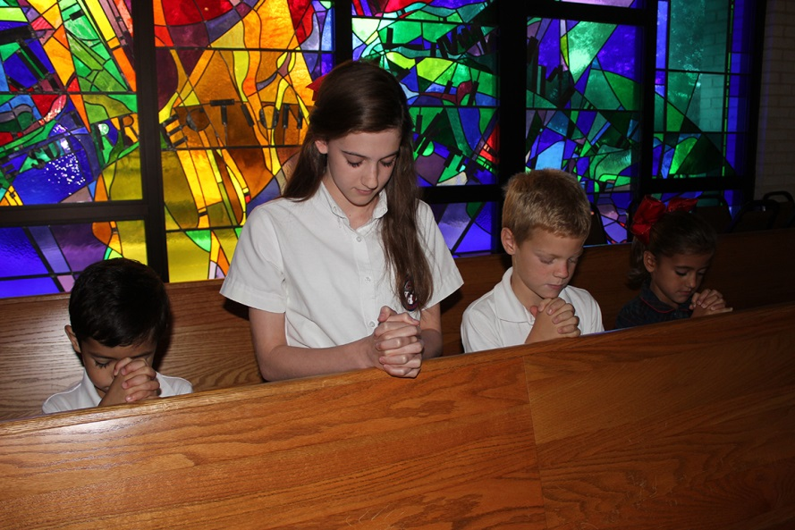
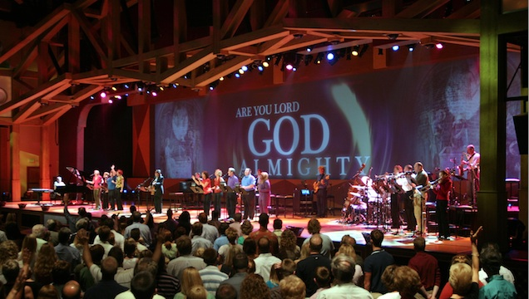
Top 10 Metrics – 3 Strategic Types (Cont’d)
Sustaining Reserves – 1 metric
Unrestricted reserves
Donor designated reserves
Notes:
Becky – the last metric we will review today discusses the sustaining reserves and how to determine the liquidity of net assets.
For each group of metrics we will give you indicators to monitor and effectively manage. We believe that by using cloud-based tools you can have statistical data convert metrics into pictures giving you forward thinking visibility and strategic oversight.

Slide 18

Forward Thinking vs Historical Assessment
Notes:
Becky – Kari – help us understand the advantages of “forward thinking visibility”.
Kari – “let’s start with defining “forward thinking” and how cloud-based tools give us real-time flexibility.”
If you are forward thinking, you are looking ahead. You favor innovation, development, and progress. People might call you bold, innovative, or pioneering.
This are the characteristics that we at Salmon Sims Thomas strive to emulate and why we’ve chosen our preferred ERP (enterprise resource planning) partner Intacct.
Intacct is a cloud-based accounting platform that allows its users real time access to financial information.
Accounting records intend to provide information on the resources available to an organization, the means employed to finance those resources, and the results achieved through their use. In order to make effective management decisions, it is imperative that these records are maintained real time so management can look ahead to what’s next, instead of simply reviewing what has already happened. With Intacct’s accessibility – available anywhere, anytime, on any device - and ease of use, these insights are more readily available. CFO’s and CEO’s have access to dashboards with a click of a button that shows them what resources they have on hand, where their resources have gone, and forecast where funds could be used based on strategic modeling.
A truly progressive means to manage their business operations!
Switch to The Intacct platform…..

Slide 19

Operating Metric #1
Effective Donor Development
Total
Contributions
# of Donors
Average Donation by Donor
=
Create a metric by location, by service, by date
“YEAR over YEAR over YEAR”
Notes:
Let’s start with looking at public support. Every church depends on donations or contributions to fund their ministry and administrative activities. By understanding your donor data base you can easily create forecast models to help with your annual budget, plus determine how your congregation could respond to a capital campaign.
The easiest donor metric is based on total contributions divided by the number of donors. This metric can be created based on dates, satellite locations, service time, etc.

Slide 20
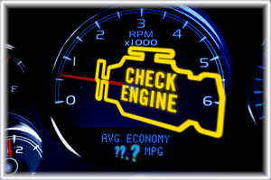
RED FLAG - Donor Development
Notes:
Becky – Kari - what are the key indicators of strength and challenges connected to donor development. Show us how these metrics look on a real-time cloud-based dashboard.
Switch to Intacct screen…
Kari – when your donor base or WEEKLY Attendance fluctuates – this can and does significantly affect average donations. When an endowment or an estate distribution is received – this significantly affects your average donation. If you are conducting a capital campaign or raising funds for specific projects, you will want to segregate these funds from you weekly tithes/offerings. By dissecting your donations as well as specific donor data – you develop a broad understanding of your donors and can begin forecasting donor trends. Here are 3 examples of donor development trending….
Consolidated donations / multi-campus church divided by total # of donors
One for multi-campuses – Month over Month
Woah! There’s a big spike in November! Let’s drill down into that number to see what’s going on! We can see there is a $500k donation misclassified to general contributions that is throwing off our average giving report. We would want to designate this into a Capital Campaign account to ensure our averages are remaining pure

Slide 21

Operating Metric #2
Effective Fundraising Efforts
Total
Contributions
Fundraising
Expenses
Cost of raising $1 of donation
=
Create a metric by fundraising event
“YEAR over YEAR over YEAR”
Notes:
Becky – Church often struggle understanding the types of internal costs that increase their tithes and offerings. Educating donors and the churches ministries and activities may clearly have a fundraising component. Any type of communication that asks donors for funds is an “appeal for funds” and therefore is considered a fundraising activity. Each Sunday when donations are solicited involves fundraising costs – which are typically centered around employees and volunteers. By properly identify all the types of costs used in soliciting funds – churches can start to analyze their effectiveness of raising funds. Consultants are often used to handle large capital campaigns. Those professional fees play a significant role in determining the cost of raising funds.
Kari

Slide 22
RED FLAG – Ineffective Fundraising
Notes:
Becky – Kari – can you show us 2 types of metrics where costs have been properly accumulated to show the reoccurring fundraising costs of weekly tithes and offering, and then show us a capital campaign with designated costs. Show us how these metrics look on a real-time cloud-based dashboard.
Switch to Intacct screen…
Kari – when you create KPIs that identify trends captured year over year you can determine the effectiveness of fundraising costs.
You can see in our first metric, we are showing the average cost to raise $1 based on the total contributions coming in divided by the total fundraising costs.
This church was averaging right around 20 cents, with a spike to 37 cents – showing us we are still operating efficiently!

Slide 23
Operating Metric #3
Effective Use of Resources
1. Program Services = Church Activities (evangelism, worship, education, missions, etc)
2. Member Development = Orientation, training
3. Support Services = General and Admin (accounting, human resources, etc)
4. Fundraising Activities = Direct and indirect costs used to raise funds
Notes:
Bill – When churches estimate the costs of “doing business” they often create a budget that defines departmental/program services, membership development, general and administrative costs and the costs of raising support (fundraising).
Churches raise support for ministry activities and are grouped as follows:
Program Services = Church Activities (i.e., evangelism, worship, education, missions)
Member Development = Orientation, Training
Support Services = General and Administrative costs
Fundraising Activities = Direct and indirect costs used to raise funds
Visualize your annual budget. How much of your resources are used to support church activities versus general and administrative costs?
Program Services
Evangelism $150,000
Worship 100,000
Education 100,000
Missions and outreach 300,000
650,000 (65%)
Member Development 75,000 (7.5%)
General and Administrative 200,000 (20%)
Fundraising Activities 75,000 (7.5%)
Total Budgeted Expenses $1,000,000 (100%)
I encourage you to review your budget and see how resources are allocated between program and supporting services (i.e., member development, general and administrative and fundraising activities). Should more resources be focused on program services? Should 80% be allocated to program activities versus 60%? Ask you donors, they will tell you.
It’s important to look at your total expenses based on the 3 categories of costs – listed above. By monitoring the ratio of costs between program, G&A and fundraising – churches can begin to identify trends based on selected criteria.

Slide 24
Operating Metric #3
Budget Analysis
Program Services:
Evangelism $150,000
Worship 100,000
Education 100,000
Missions and outreach 300,000
650,000 (65%)
Member development 75,000 (7.5%)
General and admin. 200,000 (20%)
Fundraising costs 75,000 (7.5)
Budgeted expenses $1,000,000 (100%)
Notes:
Bill – Visualize your annual budget. How much of your resources are used to support church activities versus general and administrative costs?
In our slide analysis – program services represent 65% of the total budgeted expenditures. Member development (which all churches have – however sometimes difficult to quantify) represents 7.5% of the budgeted expenditures. So 65 + 7.5% = 72.5% of direct ministry costs. The other 27.5% supports the exempt activities.
I encourage you to review your budget and see how resources are allocated between program and supporting services Should 80% be allocated to program activities versus 60%? Your donors expect a certain percentage of costs to be used in direct ministry.
It’s important to look at your total expenses based on the 4 categories of costs – listed above. By monitoring the ratio of costs between program, member development, G&A and fundraising – churches begin to identify trends and can forecast operations based on selected criteria.
60% in program service

Slide 25
RED FLAG – Expense allocations
Notes:
Switch to Intacct screen…
Kari – by using real-time data executives can easily see when expenses exceed budget controls or when unusual transactions significantly impact expense allocations. Let’s look at these metrics and allocation shifts using our Intacct dashboard.
Here is a mega-church platform that watches functional expenses between programs, membership development, G&A and Fundraising.
In October the church launched a capital campaign and incurred $150,000 of professional services to manage the 5 year campaign. You can easily see the shift between the allocation metrics at 9/30 and then at 10/31. Not only can the executive see the shift of fundraising expenses and percentages, but managers can drill down into the fundraising expenses and see the contract and the payment for the professional fundraiser. Month over month, year over year – churches can analyze their operating costs and identify variances in real-time reporting.

Slide 26

Operating Metric #4
Effective Personnel Resources
Total
Compensation
Total Expenses
Total Compensation
# of FTE
% of Budget invested in personnel
Average Employee
Compensation
=
=
Notes:
Bill - Typically a church’s single largest expense category relates to compensation and employee benefits. It takes people to conduct the church’s programming activities and the people cost includes a number of expenses that should be accumulated and evaluated on an annual basis. Payroll becomes a fixed cost for the church and these costs can be projected over time.
Total Compensation Includes
Salary/wages
Benefits
Ministry assets used for personal functions
Non-accountable expenses
EE Payroll taxes
Forgiveness of employee advances or loans
By tracking personnel costs on a monthly basis you can easily calculate the average compensation based on the number of employees. You can easily dissect this metric by separating FT and PT or Exempt vs Non-exempt payroll. By creating these metrics you can easily project the cost of adding a new campus/satellite location.
When you have a compensation cost that significantly fluctuates during the year – management can drill down into the detailed expense accounts and see what caused the metric to shift. This management change effected

Slide 27
RED FLAG – Personnel Costs
Notes:
Bill - Kari – show us what happens when the church modifies how much the employees reimburse the church for medical insurance.
Kari – When employee withholdings increase or decrease, this can significantly affect cash disbursements affecting the church’s medical benefits. In this metric example the church changed their policy effective 11/1. On Oct 31, the average employee compensation was $7,500. You can see the spike in November reflecting the new Compensation packages.
Again, we can very quickly drill down into the detail of this information to see what causes the increase

Slide 28
Operating Metric #5
Effective Facility Management
Total Occupancy Costs
Total Expenses
Total Occupancy Costs
Square Feet
Depreciation Expense
Total Expenses
=
% of Operations to maintain bricks/mortar
Cost per Square Foot
% of Operations dedicated to wear/tear of property
=
=
Notes:
Becky - Facilities require maintenance and repair and one of the most common metric is square footage cost. The older the facility the higher the maintenance costs.
Occupancy Costs include the following direct costs:
Utilities
Insurance
Repairs and Maintenance
Lawncare
Janitorial costs
Property Taxes (some states)
Churches that can create operating reserves for future repairs and replacement have flexibility on when projects are budgeted and executed. Since depreciation is a non-cash expense – think about setting aside reserves that match your annual depreciation. Strategically finance your long-term repairs by moving operating cash to reserves and savings.

Slide 29
RED FLAG – Facility Costs/Usage
Notes:
Bill – Kari – show us how the square footage metric fluctuates during February when the was an ice storm for 5 days and water pipes busted in the family life center.
Switch to Intacct screen…
Kari…… our Facility manager can easily monitor his budget and the occupancy costs for multiple buildings and campuses. In December the average cost per Sq foot was $2.02, in January the average cost was 2.35 and in February the average occupancy cost was $3.35. After the ice storm, the average cost per square foot increased drastically because of the busted pipes, and the days pumping heat back throughout the building.
Luckily, Intacct makes it easy to drill down into the vendor invoice to see the detail of those transactions!

Slide 30

Operating Metric #6
Resources to Pay Short-Term Operations
Unrestricted Cash
Annual Cash Disbursements
# of months available to fund operations
=
Notes:
Bill – Best practices indicate that churches should maintain at least 3-6 months of unrestricted cash to fund future operating expenses. By tracking this metric, year over year, cash management trends are identified and can be effectively managed. This metric helps identify a reserve policy for short-term and long-term cash flow requirements.
During your month end closing procedures – review your cash reserve metrics so that you can easily project cash requirements on a monthly/quarterly/ annual basis.

Slide 31
RED FLAG – Cash Reserves
Notes:
Bill – Kari - what do our cash reserve metrics look like for our church that hired the capital campaign consultants in October?
Switch to Intacct screen…
Kari…… On 9/30 the Church had 7 months of operating reserves. On 10/31 – the church had 6 months. The church was required to pay $150,000 in the 4th Quarter and the operating reserved dropped until the year-end donations were received and unrestricted funds were replenished.

Slide 32
Managed Resources- #7
Effective Use of External Financing
Interest Expense
Total Operating Expenses
Interest Expense
Total Debt
Total Debt
Total Net Assets
=
% of Operating Budget dedicated to 3rd party financing
Average rate of financing
Leverage - % of what third parties own of the Church’s resources
=
=
Notes:
Becky – Lending institutions want to know how much cash is generated from your operations. Churches can easily create metrics tracking interest payments compared to total expenses, interest compared to total debt and then total debt compare to net assets. How much of your operating budget is dedicated to external financing?
In our capital campaign example – the church raised and collected $1.0 million during the 4th Q of 2016. The church purchased land for $3.0 million in January 2017 and financed $2.0 with a local bank. The note bears interest at 6.0% interest and is due in monthly installments of P&I.
For 2017 – interest payments will represent _____% of the budgeted expenses, compared to _____% for 2016.
Kari – show us these metrics reflected in our dashboard.

Slide 33
RED FLAG – Leveraged Debt
Notes:
Churches can easily monitor monthly interest payments tracking budget versus actual. When these metrics fluctuate significantly Executive Pastors can easily drill down into the expenses and view the payments recorded each month. Source documents can be easily reviewed for propriety.
Switch to Intacct screen…
Kari…… Our church added a new loan to their monthly debt requirements. The new note increased the monthly interest paid to third parties and the amount of 3rd party debt also increased as a percentage of leveraged assets.

Slide 34
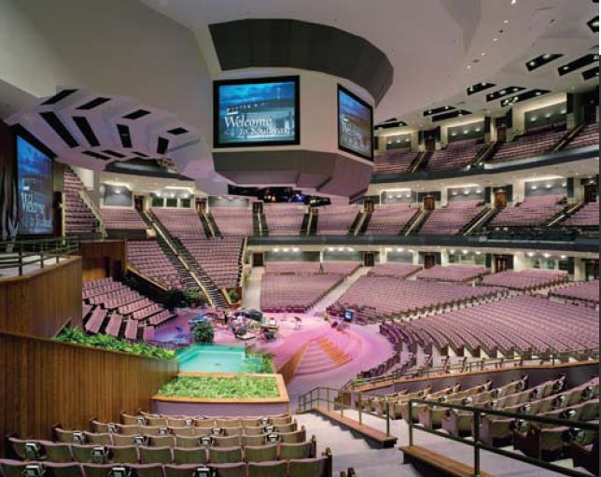
Managed Resources- #8
Effective Use of Ministry Assets
Total Property, Plant and Equipment
Total Assets
% of Assets Used for
Program/Support
Services
=
Notes:
Bill – Are most of your church’s assets comprised of permanent or long-term assets? Create metrics that analyze the composition of your assets and use these metrics year over year to strategically plan for future growth and expansion.

Slide 35
Managed Resources- #8
Effective Use of Ministry Assets
Assets:
Cash |  |  |  | $ 20,000 | 2% | Current liquid reserves
Certificate of deposit |  |  |  | 75,000 | 8% | Current liquid reserves
Pledges - unconditional |  |  |  | 5,000 | 1% | Semi-liquid – converts near term
Investments – endowment |  |  |  | 150,000 | 15% | Long-term - donor restricted reserves
Property, plant and equipment - net |  |  |  | 750,000 | 75% | Long-term - invested reserves
Total Assets |  |  |  | $ 1,000,000
Notes:
Bill – Resources are accumulated during the organizational life of the church. Assets are either defined as liquid (cash or cash equivalents), semi-liquid – converting to cash in the near term (pledges) or permanent (property/equipment).
Assets that are cash and convert to cash within a year are used to fund the operations of the church. In the example above – the pledges should be collected within the year and can be included in your short-term cash funding requirements. Investments and fixed assets are generally considered long-term or permanent type assets. Investments may or may not be liquidated to fund operations depending on donor restrictions. Investment earnings may or may not be restricted for specific purposes based on the donor’s intent or direction. Facilities and related equipment are typically used to promote the operating activity of the church.

Slide 36
RED FLAG – Fixed Assets
Notes:
Switch to Intacct screen…
Kari – let’s look at our church’s assets and determine the composition of long-lived assets.
Kari – Within Intacct we can easily monitor the percent of reserves. Our report shows the Prior Year vs Current Year asset balances, the percent they make up in the asset reserves, and well as the overall percentage of change from prior year to current year.

Slide 37

Managed Resources- #9
Effective Use of Investment Property
% of Assets Invested Externally
Average ROI
Total Investments
Total Assets
Investment Earnings
Total Investments
=
=
Notes:
Becky – the metrics outlined here are the 2 basic ratios used for investments. Investments can include real-estate, public and privately traded securities, art-work, paintings, etc.

Slide 38
Managed Resources- #9
Effective Use of Investment Property
Asset Description | Cost | Fair Value
Equity securities | $ 65,000 | $ 85,000
Bonds | 45,000 | 48,000
Mutual funds | 12,000 | 17,000
Total investments | $ 122,000 | $ 150,000
Notes:
Becky – using the same information discussed earlier let’s look at the church’s endowment portfolio. Based on the donor’s directive, the Church could invest the corpus in marketable securities and the earnings could be used for the general operations of the church.
We can easily track the cost and the fair market basis in our investment metrics. The composition can be tracked year over year and analyzed with the earnings generated from each type of investment.
Kari – what would this look like in our Intacct platform?

Slide 39
RED FLAG – External Investments
Notes:
Switch to Intacct screen…
We’ve built a report for our church to track how effectively they are using their investment property. We can see that this year they have roughly 29 million in invesments, but have only earned 2.5 million off the property. Averaging an ROI of 8 cents. This is not a very effective use of property at this time, but the church can continue to monitor this metric to make management decisions in the future.

Slide 40

Sustaining Resources - #10
Notes:
Becky – our last metric is the sustainable operating metric. It is not based on an account buried in the profitability of the organization (i.e., statement of activities or profit and loss). We believe that sustainability is revealed in the statement of financial position or balance sheet of the church. The account that holds the accumulates reserves of the church is called a net asset. In any kind of business, the amount of funds that remains after all the liabilities have been liquidated is considered the equity of the organization.
What are the components of your church’s accumulated reserves that can be used for operations tomorrow, next week, next month, and so forth?

Slide 41
Sustaining Resources- #10
 | Reserve Analysis
 | Assets:
 | Cash |  |  | $ 20,000 | 2% | Liquid asset
 | Certificate of deposit |  |  | 80,000 | 9% | Liquid asset
 | Property, plant and equipment - net |  |  | 750,000 | 88% | Non-liquid/Permanent asset
 | Total Assets |  | A | $ 850,000
 | Liabilities:
 | Accounts payable |  |  | $ 7,000 |  | Current liability
 | Note payable |  |  | 450,000 |  | Long-term liability
 | Total Liabilities |  | B | 457,000
 | Net Assets
 | Unrestricted |  | A-B=C | 393,000 |  | Reserves
 | Total Liabilities and Net Assets |  |  | $ 850,000
Notes:
Becky Slide – here is an example of a church’s statement of financial position.
Assets are what the church owns. Liabilities are what the church owes. As long as the church has more assets than liabilities there are reserves. In the above example the church has accumulated earnings/reserves of $393,000 since inception. The type of unencumbered assets always determine the quality of the reserves.
Let’s determine the quality or components of the net reserves. We must determine the types of assets owned and liabilities owed. In other words are the assets current or long-term and more importantly how long does it take for those assets to convert to cash. Cash is king. Cash represents the most liquid asset of an organization and the resources to pay the operating expenses of the church. Without cash the church can’t pay employees or vendor invoices on time.
Managing cash is critical to building reserves.
In our example we have defined the types of assets the church owns. Look at the types of assets, either defined as liquid (cash and cash equivalents), semi-liquid (converts to cash soon) or non-liquid/permanent (must sell or liquidate to convert to cash).
Let’s analyze these reserves.

Slide 42
Leveraged Reserves
 | Reserves Include:
 | Liquid ASSETS:
 | Cash + CDs + Prepaid Expense |  |  |  | $ 100,000
 | Minus: AP and Accrued Liabilities |  |  |  | (7,000)
 | Equals: Liquid Assets to fund operations |  |  |  |  | 93,000 | 24%
 | Non-Liquid ASSETS:
 | Property, plant and equipment - net |  |  |  | 750,000
 | Minus: Debt related to PP&E |  |  |  | (450,000)
 | Equals: Unencumbered long-term assets |  |  |  |  | 300,000 | 76%
 | Unrestricted reserves includes: |  |  |  |  | $ 393,000 | 100%
Notes:
Becky – based on the types of assets – the liquid assets represent $93,000 or 24% of the total reserves.
The permanent (non-liquid assets) represent $300,000 (asset less related debt) = the unencumbered asset value or 76% of the total reserves.
The critical issue is how many months of expenses can be paid from the liquid reserves? This reserve metric relates to metric #6 – how many months of operating expenses can your unrestricted cash sustain.
Some churches have a very simple sustainable metric model, as reviewed above. Most churches have difficult, often complex, operating models. Understanding the components of your church’s reserves allows the executive team the ability to properly plan for current and future ministry activities, and more importantly the funding risk.
Bill – what type of advice do you give your clients?

Slide 43
RED FLAG - Reserves
Notes:
Becky – Kari – what kind of net asset analysis can you show from our Intacct platform?
Switch to Intacct screen…
Kari –
As you can see we created these reserve analysis reports in Intacct and added them to our dashboards. We very easily can create the custom reports with computations, then expand the report out by month, quarter or year. We can also create these reports as cash projects for the upcoming year easily within Intacct.
We also added the totals for liquid assets, unencumbered long term assets, and UNR Reserves as performance cards onto our dashboards. Management can see those total numbers quickly at a glance without getting into the detail of the makeup if they want a 30,000 foot view
Becky - One of the key takeaways today for our churches is to be very cognizant and careful of the type of donations you accept, and more importantly, understand the impact on your unrestricted reserves.

Slide 44

Key Points
What Drives Your Sustained Ministry?
Operational Metrics
Managing Long-Term Resources
Unencumbered/Cash Reserves
What’s measured can be managed and controlled for long-term sustainability.
Notes:
Becky – take a look at your church’s metrics. What areas can you strategically iimprove in the short-term? What goals can you create for long-term sustainability. Remember – there are 3 categories of church metrics: operational activities; long-term resources and cash reserves.
Numbers tell the story – your ministry story.

Slide 45

Question/Comments

Slide 46
